Slide 1
SNAP4CT.org
A Communication and Education Platform for SNAP-Ed

Slide 2
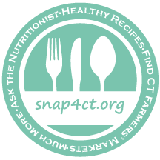
The Evolution of SNAP4CT.org
FY 2014/2015 – initial development of the website and Facebook presence and You Tube Channel (Spring 2014 soft launch)
FY 2016 – added the “Ask a Nutritionist” feature and grocery store tour videos; live-streaming grocery store tours; added content from vetted sources
FY 2017 – added remaining social media (Instagram, Pinterest); hired a RDN with substantial social media and communications/marketing background; added SEO and online marketing, rebranded with new logo
FY 2018 – continued focus on growing engagement
Notes:
What’s Cooking USDA Mixing Bowl – staffing – students vs. professional staff

Slide 3
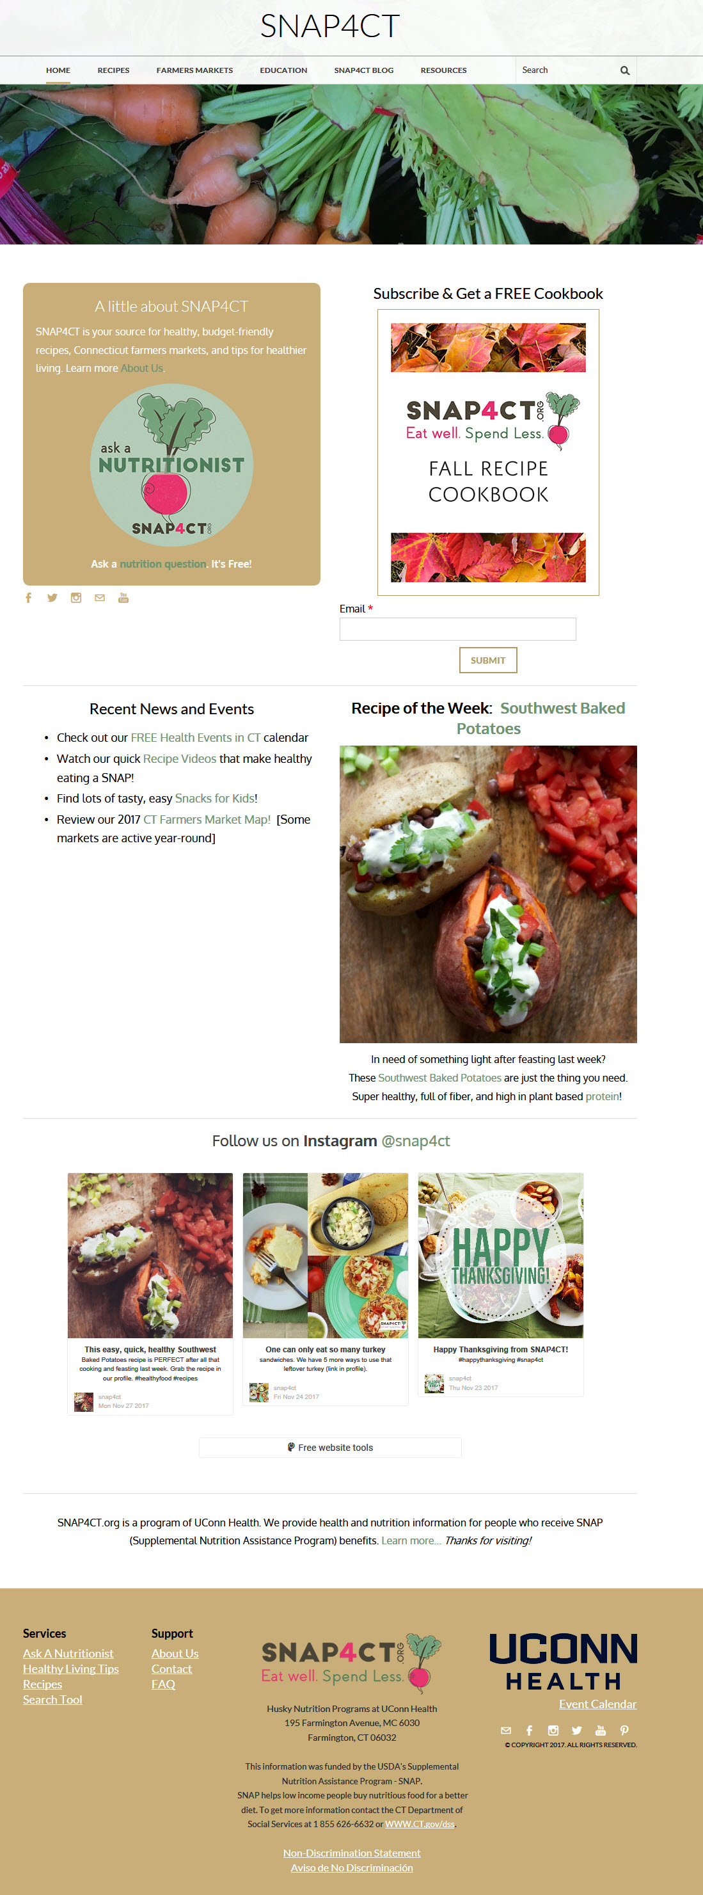
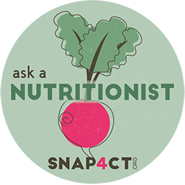
SNAP4CT.org’s Features…
Searchable Recipes
Health Living Tips & Videos
“Ask a Nutritionist” Button
SNAP4CT Blog
eNewsletter Subscription & FREE Cookbooks
Tools – Interactive Farmers Market Map
Events Calendar
Department of Social Services office locations

Slide 4
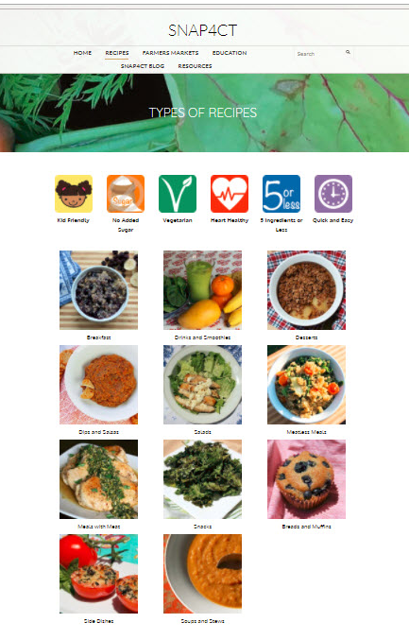
SNAP4CT.org’s Benefits…
Offers meal and snack ideas that have been tested and assessed for their nutritional quality.
Engages visitors with appealing imagery, infographics, cookbooks, and videos.
Provides simple, practical lifestyle tips via the monthly blog and eNewsletter.
Incorporates a variety of community resources including free events, the SNAP-Ed events calendar, and resources for accessing SNAP benefit information.
Provides free access to Registered Dietitians for nutrition questions.
In addition, the integrated social media platforms enable the delivery of simple, targeted wellness messaging and community updates.

Slide 5
Growth Over Time
34,895

Slide 6
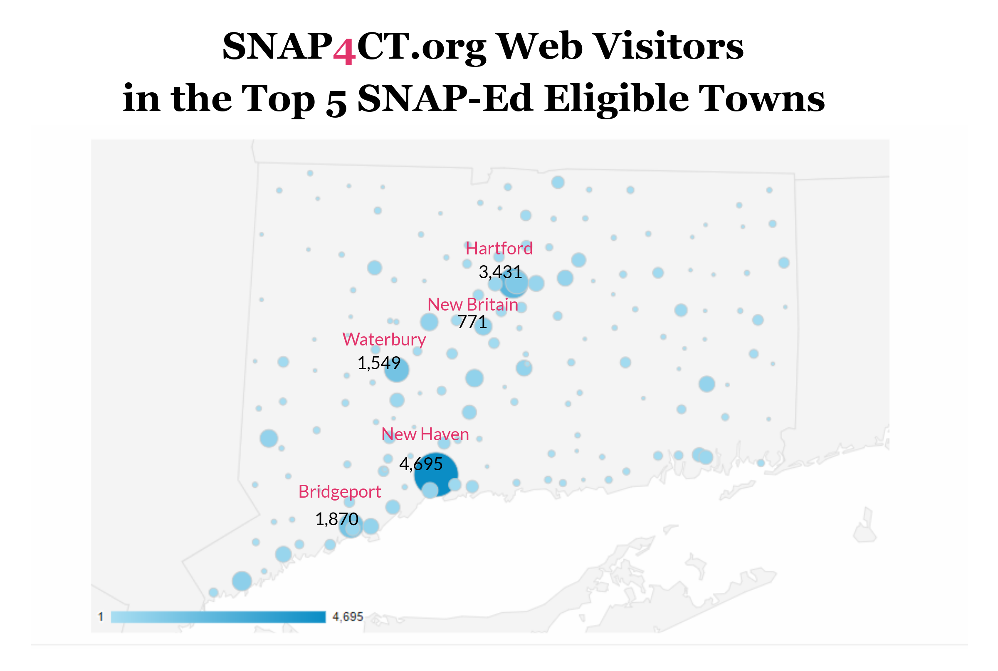
Towns Reached in CT (of 169 Total)

Slide 7
Online Marketing
Facebook Campaigns
Facebook ads campaigns allows us to target a very specific audience of Facebook users based on location, age, and interests.
Using a limited budget ($4-20 per week), we are able to promote content and events to individuals in towns with the highest SNAP participation.

Slide 8
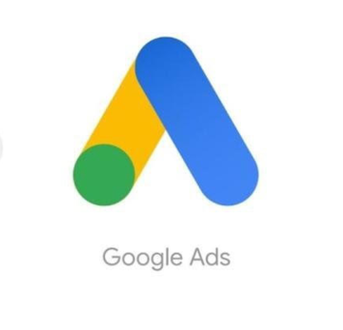
Online Marketing
Google Ads Campaigns
Google Ads campaigns help to drive traffic to specific content based on a web searcher’s location and terms that you believe your audience may be searching for (i.e. CT farmers markets, recipe videos, healthy shopping and eating tips).
You are able to control how much you spend on terms and carefully track what is working.

Slide 9
Follow SNAP4CT.org…
Social Media Links
Facebook https://www.facebook.com/snap4ct/
Instagram https://www.instagram.com/snap4ct/
Twitter https://twitter.com/snap4ct
Pinterest https://www.pinterest.com/snap4ct/
YouTube http://www.youtube.com/c/snap4ct
For More Information, contact: Susan Furbish, RDN at furbish@uchc.edu

